Slide 1
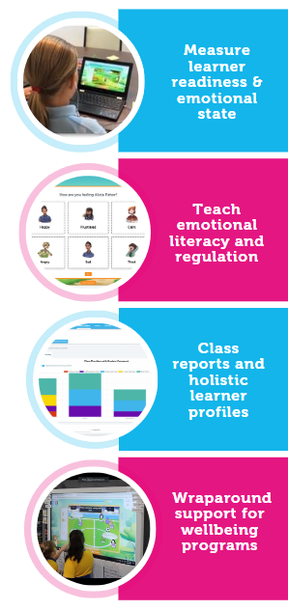





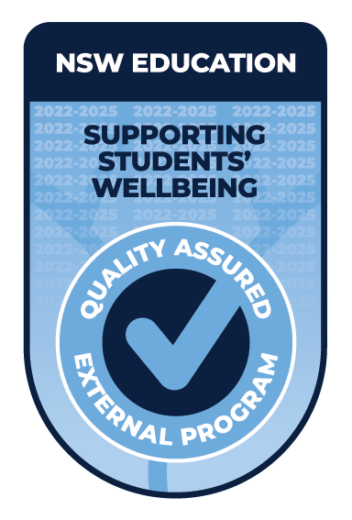
Integration

Slide 2

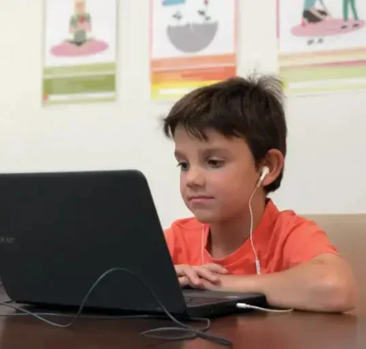
Sentral GO Integration
Executive Summary
The Life Skills GO Emotion Check-in Sentral integration allows the roll call and check-in to be conducted simultaneously.
Reporting dashboards sit within Sentral to provide a full holistic learner profile for each student including emotional state with context and readiness to learn.
Real-time data can be viewed by individual student, class, stage or at a whole school level.
Permissions are granted to individual staff via assigned roles to provide appropriate access to reports and data.
By combining roll call, the Emotion Check-in and data into one learner profile, teachers are able to significantly reduce their workloads.

Slide 3
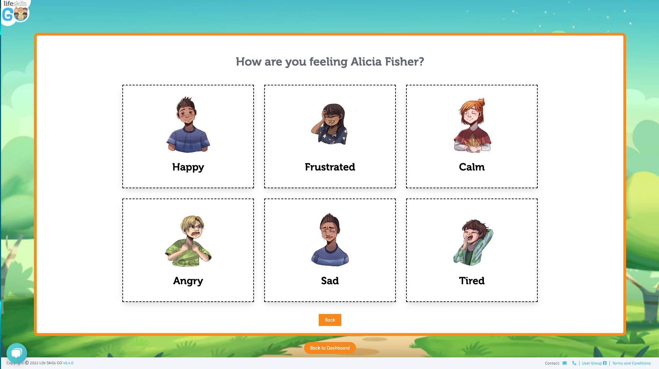
How Life Skills GO Works For Teachers
The Emotion Check-in
Traditionally, student wellbeing has measured behavioural incidents such as suspensions.
With Life Skills GO, teachers are provided the real-time data to identify the emotional state of each student in any moment and provide support or take preventative action where required.
Give students agency to express their emotions with student-led Emotion Check-ins.
Provides teachers with instant visibility on the emotional state of all their students.
Creates a quick daily habit for students to identify their emotions at key moments such as morning roll-call, after lunch, or before they go home to develop emotional literacy, improve self-regulation and reduce classroom disruption.
Available emotions increase by Age/Year and understanding to ensure that emotional regulation is built up from a solid foundation.
Track and measure the wellbeing of your students immediately and over time to identify trends, set ILP/PLP’s and move into a preventative space.
Check-ins can be run simultaneously with roll-call and independent of attendance at a any time of the day.

Slide 4
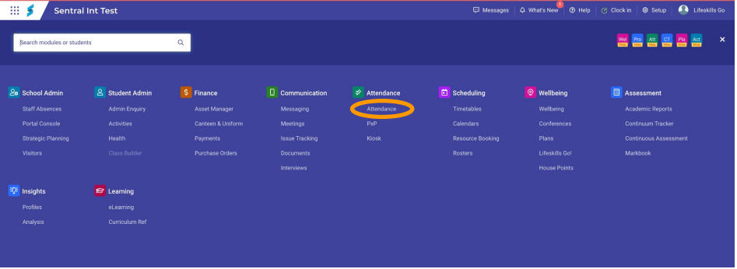
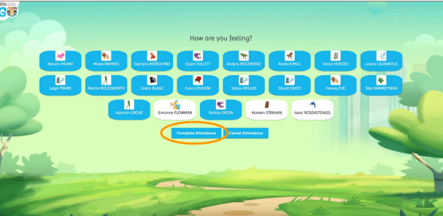
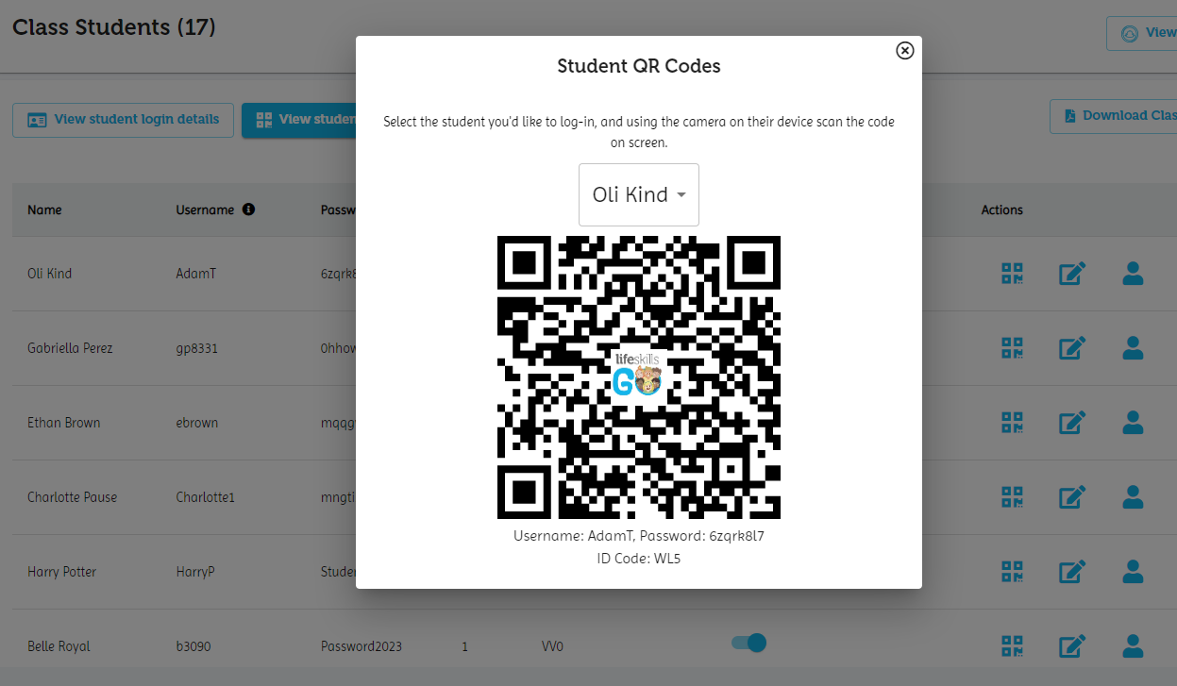
Life Skills GO Works For Teachers
Running a daily Attendance Check-in
Using the Life Skills GO check-in to mark the roll on Sentral, you can
simultaneously record students’ emotional response and attendance. The check-in counts as the student being present for attendance purposes.
No additional work is required to collect real-time attendance, learner readiness and emotional state data.
Students can access the Emotion Check-in tool through different methods, depending on their access to devices and level of comfort sharing how they are feeling with their classmates.
The different methods of access:
Student devices using QR codes or student logins
Class check-in on an interactive whiteboard involving the whole class or small groups

Slide 5
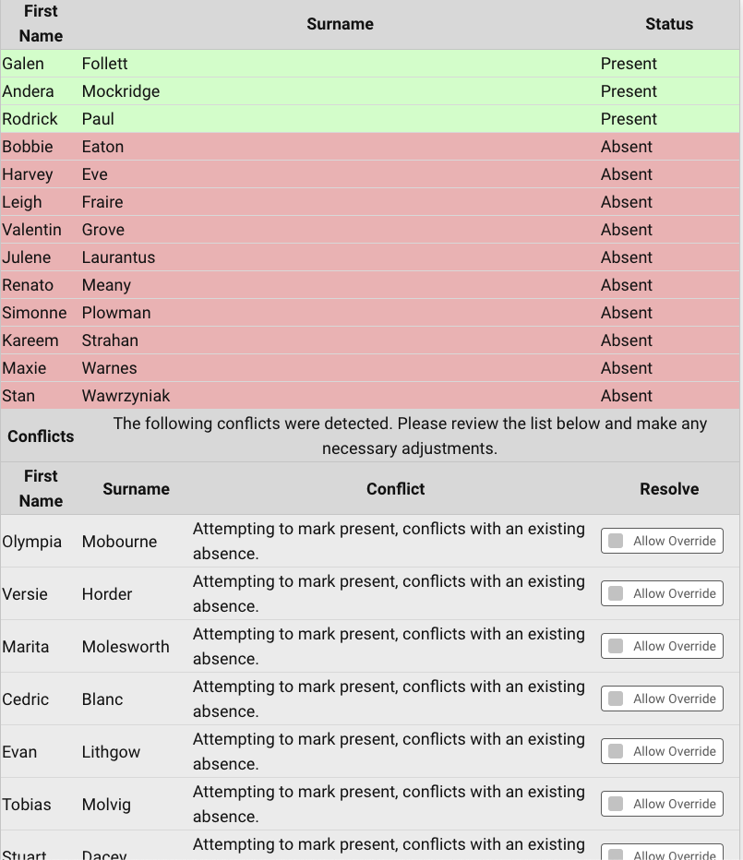
Life Skills GO Works For Teachers
Life Skills GO Emotion Check-in linked to attendance
Each students’ check-in data is pushed back into Sentral’s attendance roll to be checked and submitted.
When all students present have checked in, click Complete Attendance and then Complete on the confirmation page. This is the same confirmation page you would normally use to verify the attendance records are correct.

Slide 6
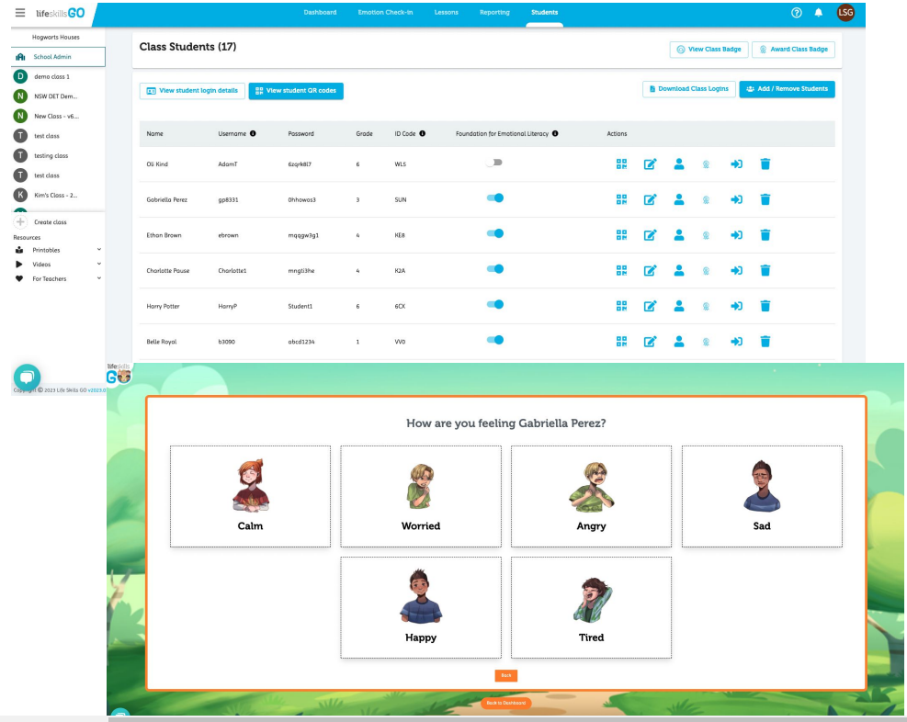
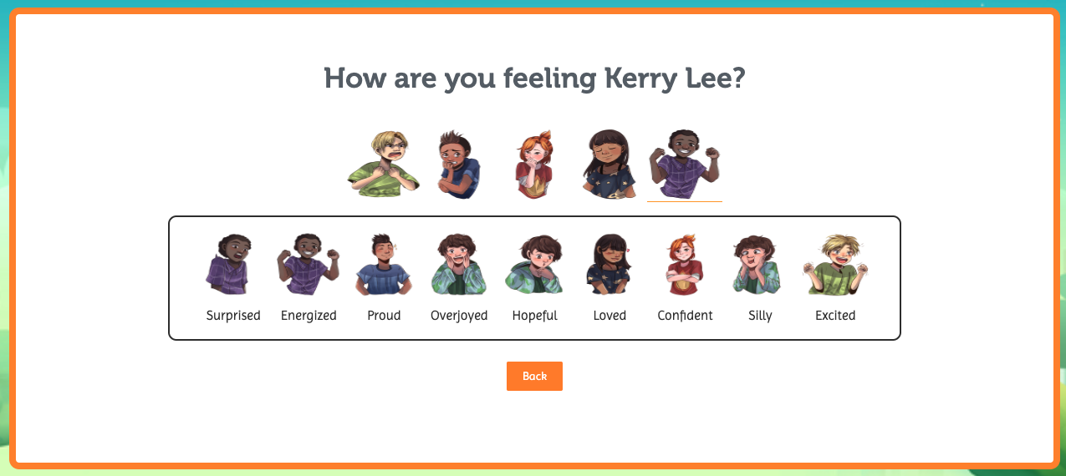
Life Skills GO Works For Teachers
Running a daily Attendance Check-in
Foundation for emotional literacy
To help students develop a fundamental understanding of emotional literacy, the educators can toggle on Foundation for Emotional Literacy option for them.
This version of the Emotion check-in has 6 basic emotions to make it easier for educators to build a foundation for their students.
The platform scaffolds to suit the needs of students by providing more complex emotions to choose from as they grow their understanding of emotions.

Slide 7
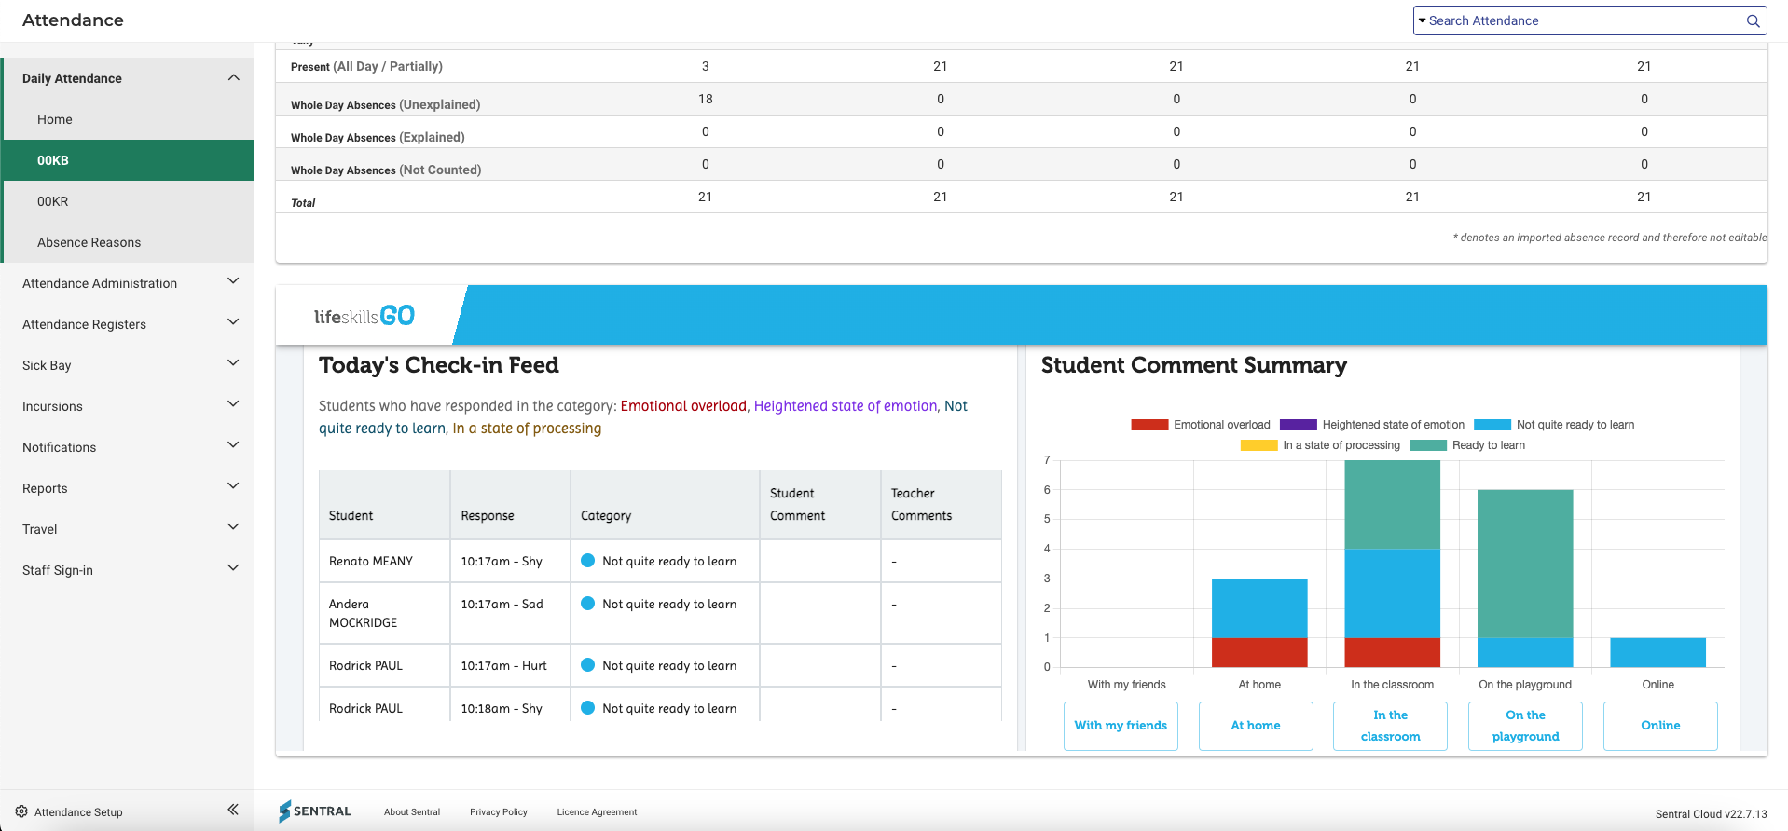
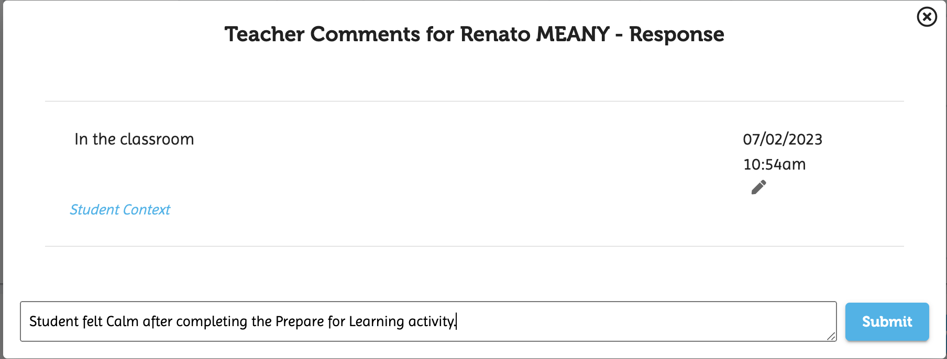
Life Skills GO Works For Teachers
Identify student areas of need
The easy to navigate feed provides clear visual feedback on each students response, context and learner readiness.
Teachers are able to add their own comments to add context to their observations.
This data rolls up into Sentral’s student profile.
Student Context summary

Slide 8
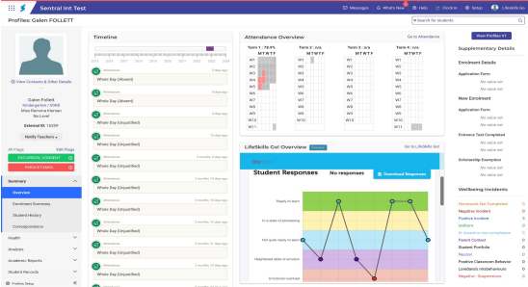
Life Skills GO Works For Teachers
Real-time feedback of emotional state and learner readiness
Provides teachers with an instant snapshot of their students' readiness to learn and emotional state. This helps with regulation and for teachers to move into a preventative space by quickly identifying student emotions before they present in class.
Instantly review students' emotional states and take immediate action to support readiness to learn and prevent behaviours presenting in the classroom.
Triangulation of attendance, behaviour and check-in data to assess a student's wellbeing.
Build a holistic learner profile

Slide 9
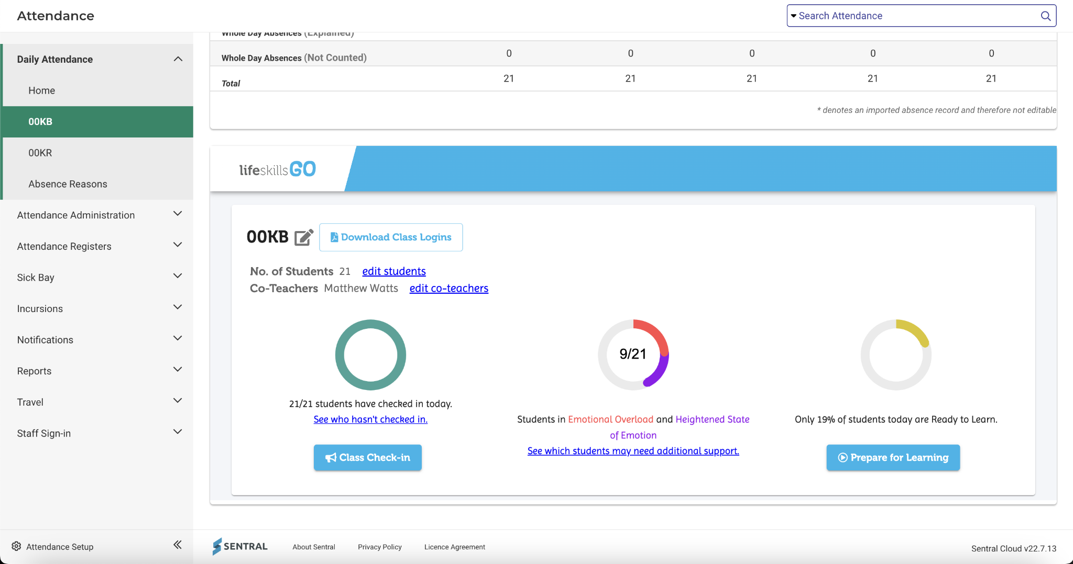
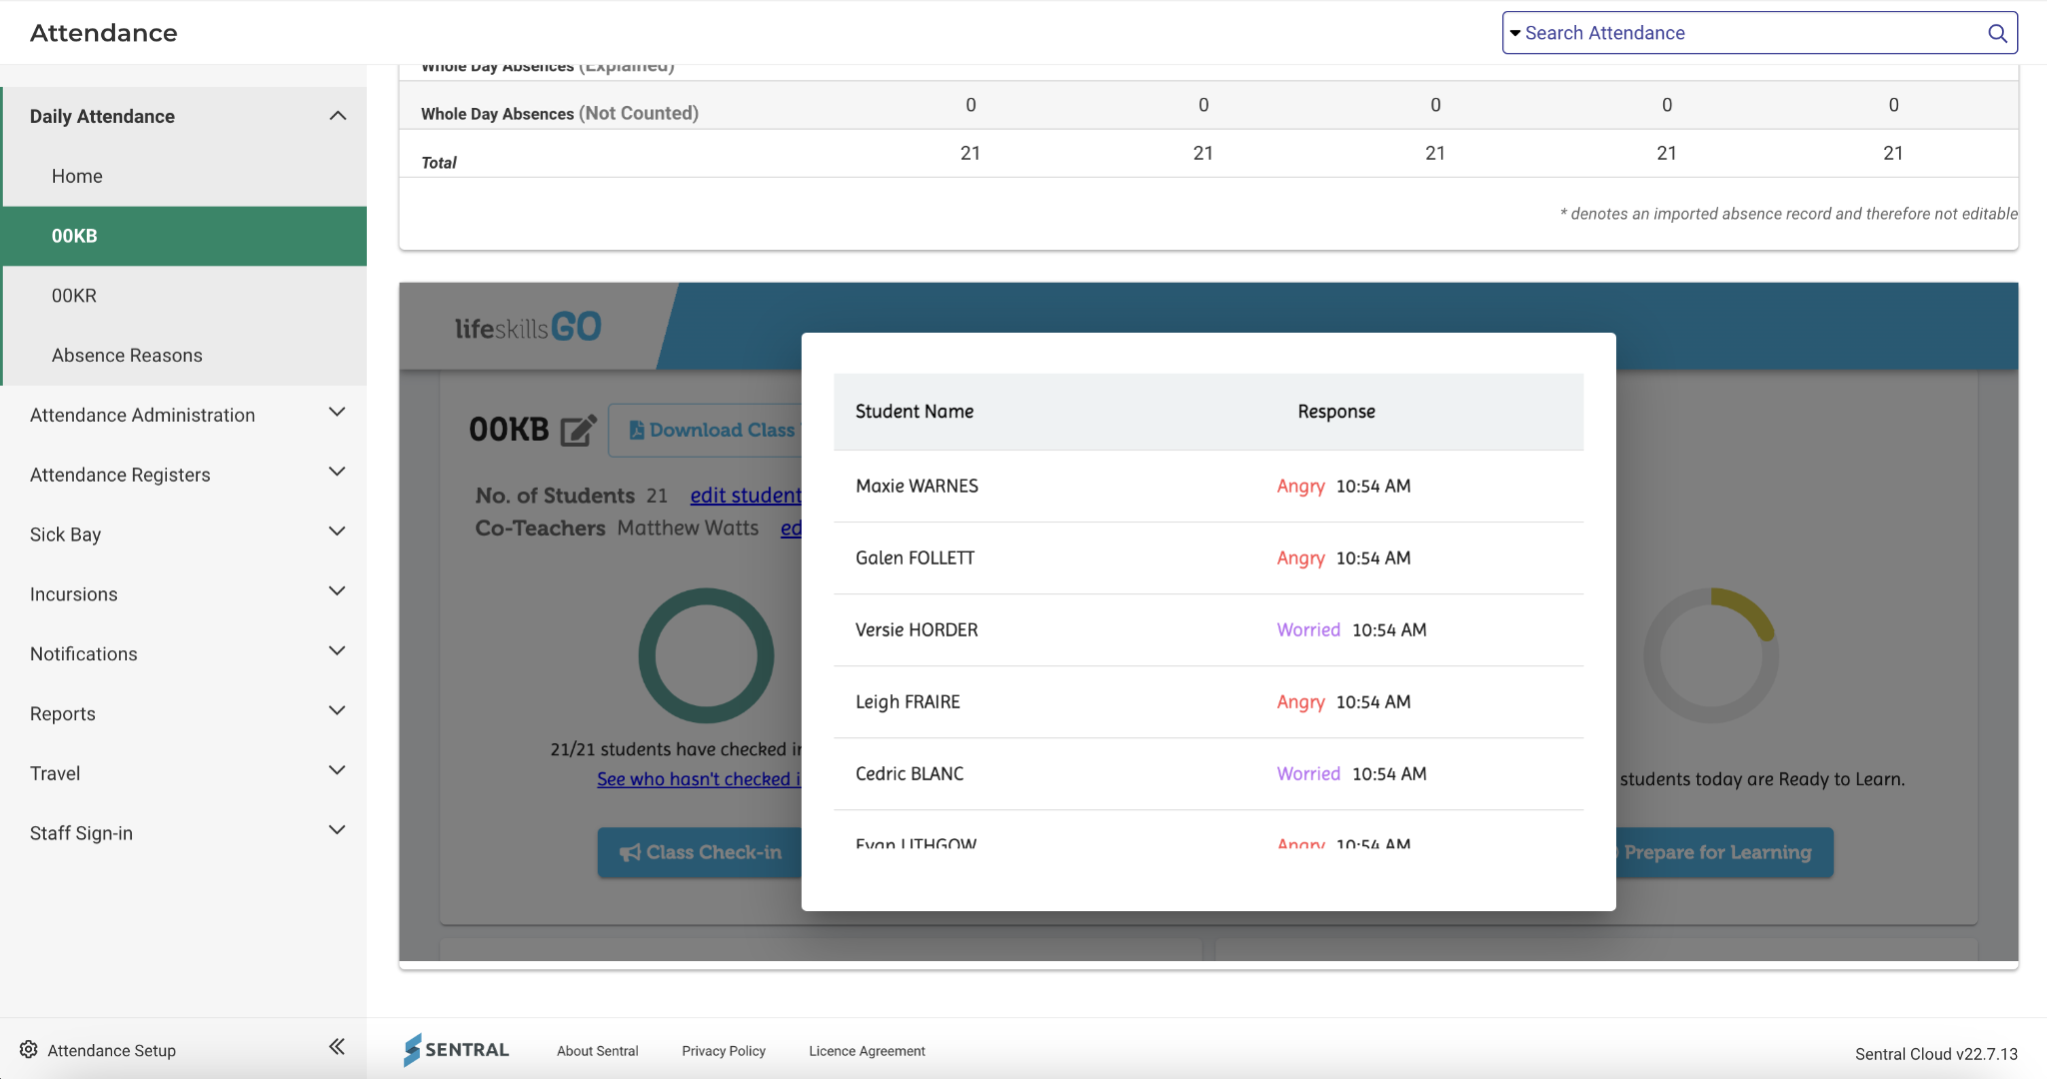
Life Skills GO Works For Teachers
Class summary
The Teacher Dashboard provides teachers with an instant snapshot of their students' readiness to learn and students in need. This helps teachers to move into a preventative/proactive space by quickly identifying student emotions before they start the day.
Three ‘doughnuts’ provide a clear summary view of all students’ emotional state and the percentage of students ready to learn.
Gain quick insights into learner readiness and see real-time changes in emotional state.
Identify patterns and review teacher comments
Develop a deeper understanding of what is happening for each student.
Provide a platform for students to feel heard and to have a voice.

Slide 10
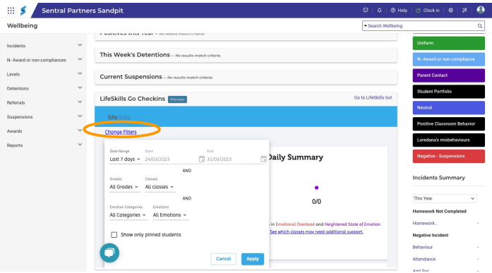
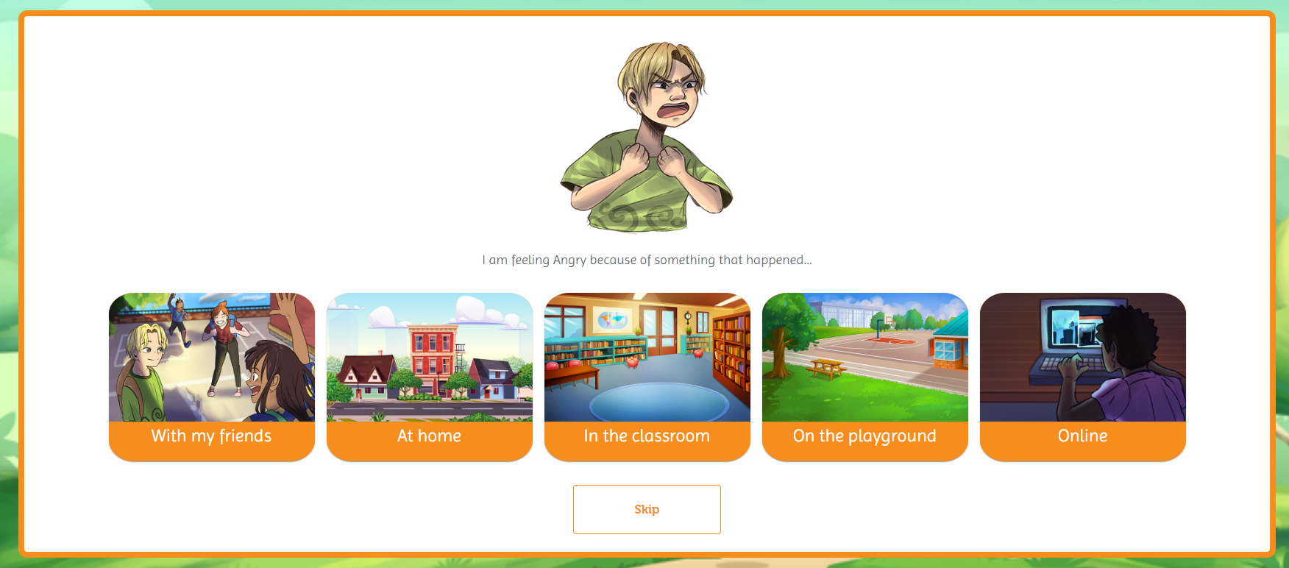
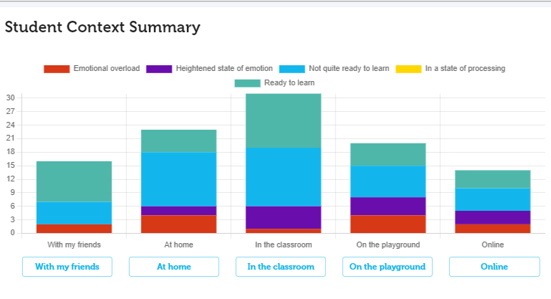
Life Skills GO Works For Teachers
Reporting From a Class Level
Filter reports by selected fields
Teachers are able to filter the results based on a number of parameters including date range, grade, class, emotion category, emotion and pinned students, allowing teachers to pull out data relevant to their needs.
This enables teachers to clearly view reports and data based on the most relevant information.
Student context summary
The Student context summary shows an overview of the context each student selects as part of their check-in indicating where these feelings are originating, such as at home or in the playground.

Slide 11
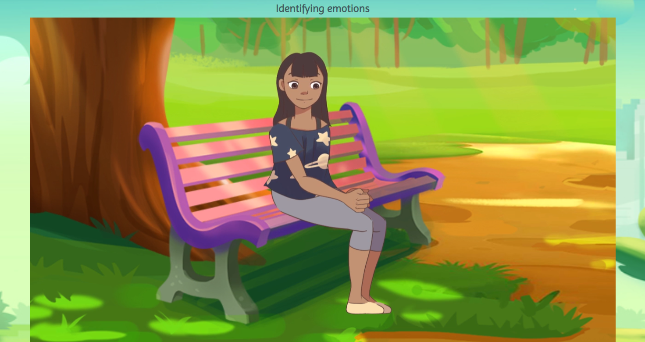
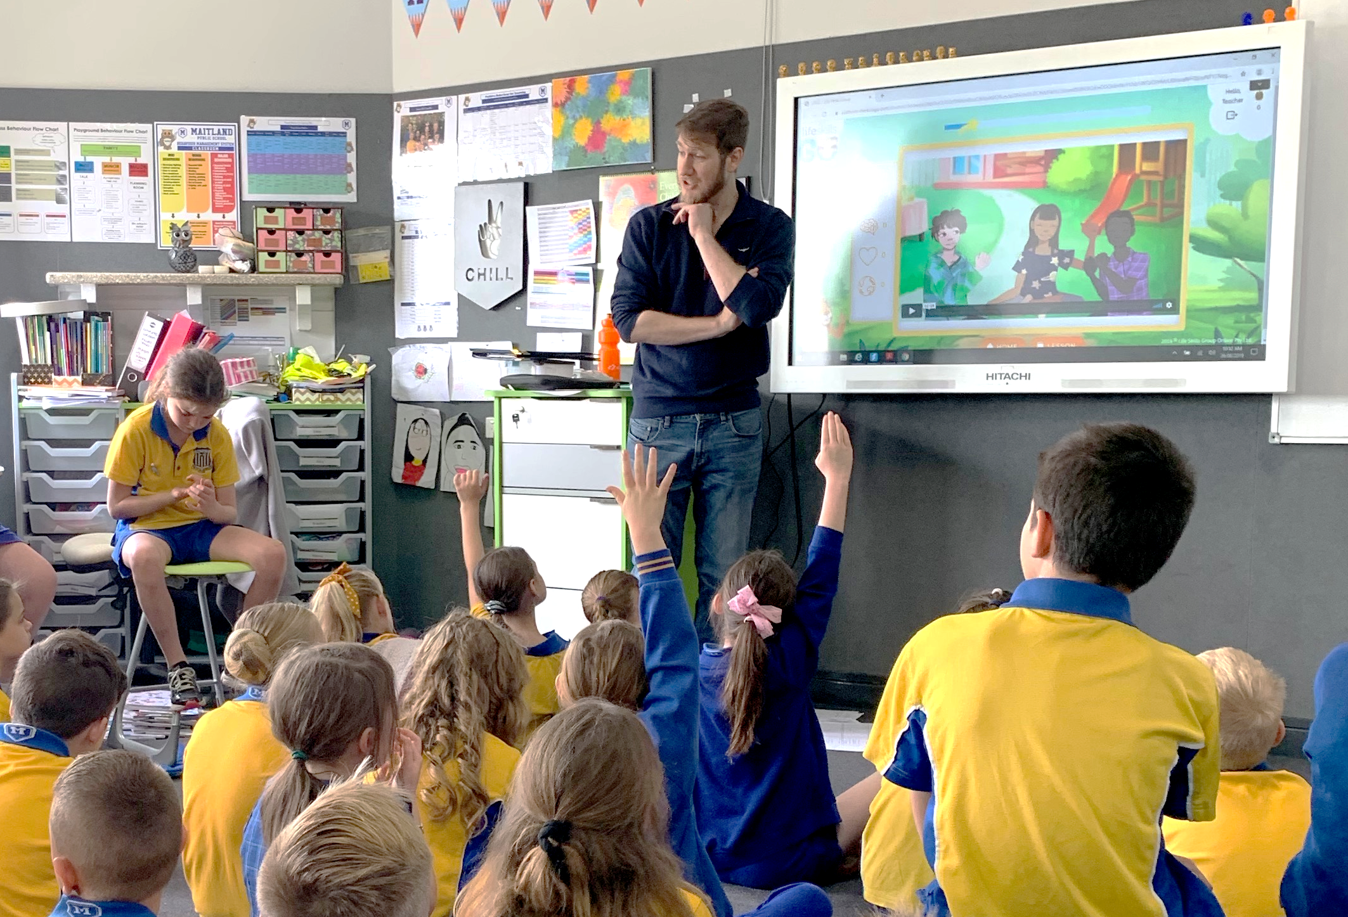

Life Skills GO Works For Teachers
Support learner readiness with Prepare for Learning activities
These activities can be student or teachers led to improve learner readiness or help with self-regulation as required.
Rapidly move students into a state of learner readiness, with adaptive content delivered instantly based on student driven data.
Once students identify how they are feeling a cognitive behaviour therapy, focused attention or mindfulness video is automatically selected to reinforce understanding of how that emotion looks and feels, as well as providing students with explicit self-regulation tools.
Students then have another opportunity to identify their emotional state, with before and after results displayed reinforcing the learnings.
Guide and create readiness for learning for individual students or the whole class.
Use emotion cards as prompts to teach new emotions week by week.

Slide 12
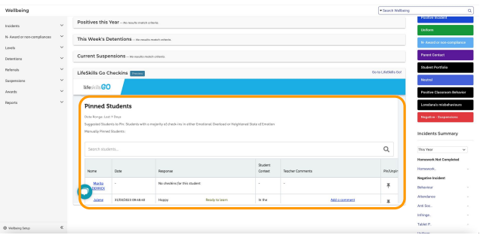
Life Skills GO Works For Teachers
Maintain visibility over student directed data with Pinned Students
The Pinned Students card allows teachers to maintain visibility over students that may need additional support based off their check-in responses.
Students that have been manually pinned will appear at the top of the list.
Suggested students to pin will appear in the list if they have selected emotions in emotional overload or heightened state of emotion for more than 50% of their check-ins for the date range selected.
Teachers can manually pin and unpin student records to their dashboard as needed.

Slide 13
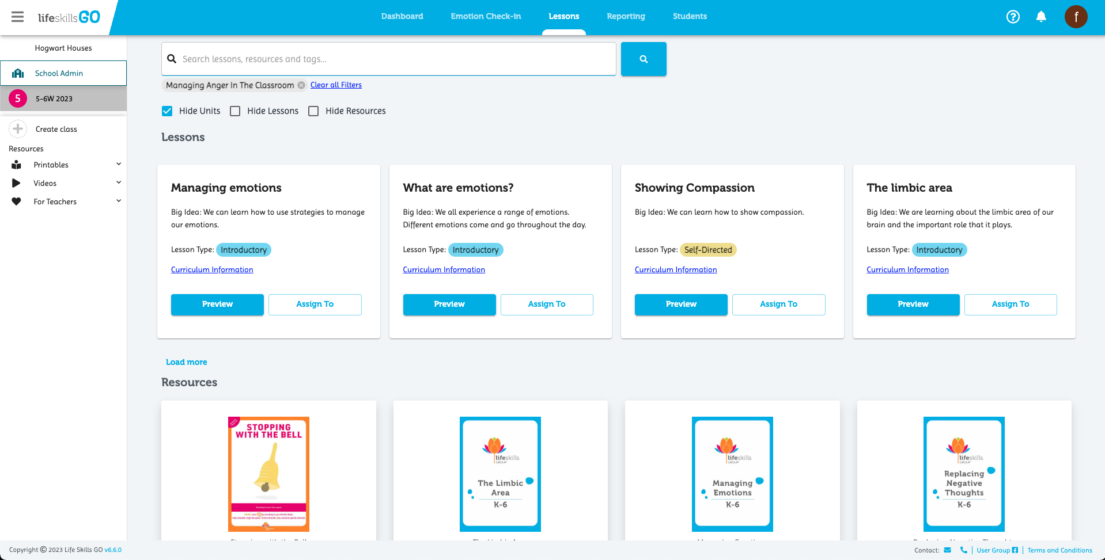
Life Skills GO Works For Teachers
What next?
Build holistic learner profiles and easily create ILP/PLP’s using the included content.
Assign curriculum aligned activities or units targeting resilience, relationships, emotional literacy and future focused learning skills to individual students, groups or classes with just a few clicks.
Review progress against learning outcomes.
Life Skills GO content is included as part of the Whole School licence. Please contact us if you would like to learn more about this option.

Slide 14
For administration and school leaders

Slide 15
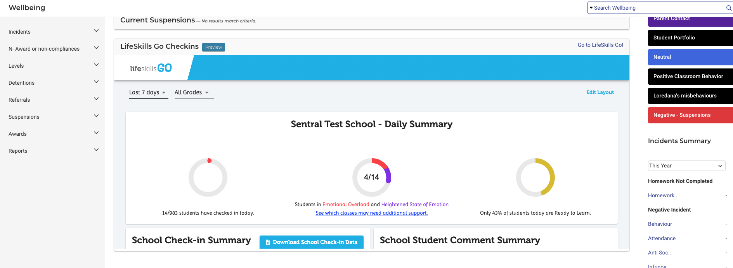
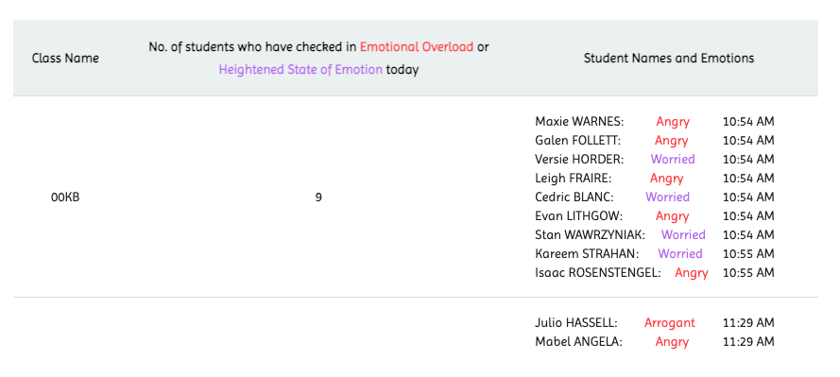
Life Skills GO Works For Executives
School summary
The easy to navigate feed provides clear visual feedback on each students response, context and learner readiness at a whole school level.
This data rolls up into Sentral’s student profile.
Administrators on Sentral are
able to sync data across the platform using the Sync button that appears in Sentral - teams do not have to manually update different sources with new student records

Slide 16
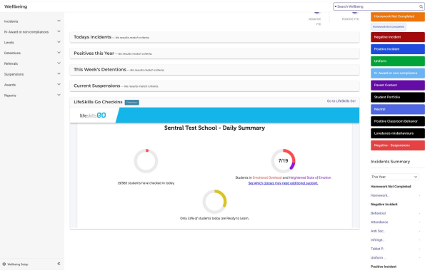
Life Skills GO Works For Executives
Gain visibility over school wellbeing data with real-time reporting
Executive or Administrators on Sentral can view a summary of the school’s check-in data in the Wellbeing section.
Instantly review student emotional states and readiness to learn reports to allow teachers to work in prevention and increase learning.
Filter by common stressors to see how students are feeling and where these feelings are originating, such as at home or in the playground.
Identify why students are reporting their emotions. Useful for creating recommendations for students and focusing on preventative measures.
Gain visibility over individual emotion responses over time.
Identify patterns and review teacher comment trends.
See early indicators and real-time changes in emotional state.

Slide 17
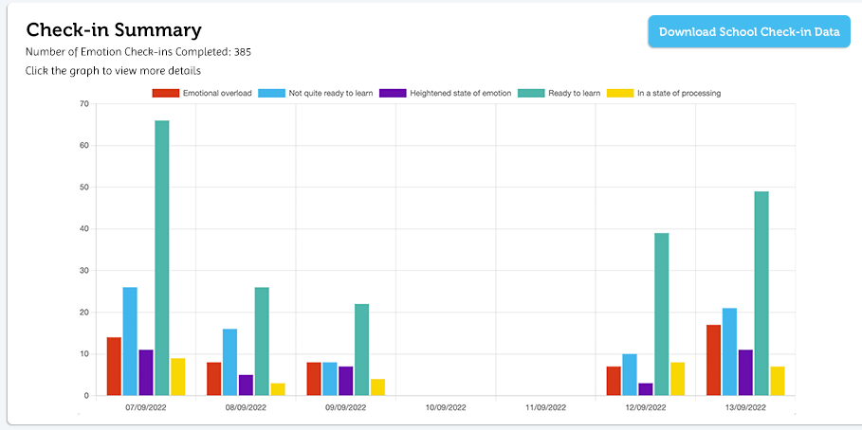
For Principals, Admin, Stage and Wellbeing Staff
Track and measure wellbeing activity across all students, classes or the whole school
View engagement with the Emotion Check-in and digital lessons for every class or at a whole school level
A combination of accountability and whole school decision making.
Track progress of the school's wellbeing strategy implementation.
This data can be used for external validation purposes
School administrators are able to see when staff last logged in to the platform to support consistent usage of the platform.

Slide 18
Data security
Life Skills GO collects, processes, stores and shares data in accordance with our privacy policy* for the sole purpose of providing our services.
No data is collected, stored or shared for any other purpose unless explicitly stated in the policy.
Life Skills GO data is stored on Amazon Web Services (AWS) provided cloud storage in Australia.
To protect data that we process and store, we use several industry standard practices including:
Encryption in transit using TLS1.2 or higher
Encryption during rest of data stored in our system, using symmetric key encryption and the AES-GCM algorithm with 256-bit keys
Minimal Personally Identifiable Information (PII) is stored for the sole purpose of providing our service. Extraneous data that we may receive during the processing of data (extra spreadsheet fields, Sentral data) is ignored and removed as soon as practicable.
Life Skills GO has a System Hardening Policy detailing how we manage service updates, apply security patches and the timelines which these should be completed by.
Life Skills GO has an Information Security Policy & Key Management document which details how staff should access data, under what circumstances this is permitted and the roles and responsibilities of key staff. Life Skills GO operates under a least privilege approach, allowing staff minimal yet sufficient privileges to carry out their duties.
All staff are required to have MFA/2FA enabled to access any company account, including Life Skills GO systems / cloud providers, company email and related items.
Life Skills GO has been assessed by ST4S under ESA and the results of this assessment are available.
* https://www.lifeskillsgroup.com.au/privacy-policy

Slide 19
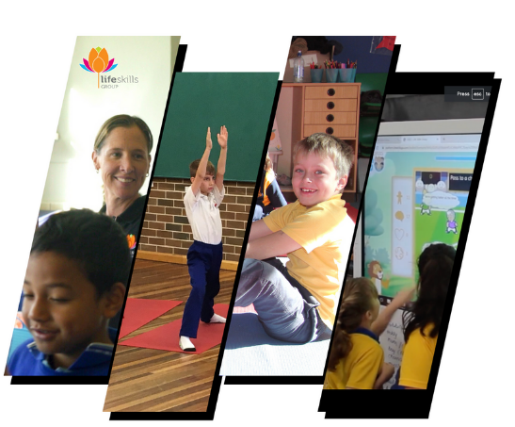
In-school Programs
These programs have been specifically developed for students in each year level from primary through to secondary school. Learning can be personalised to meet the needs of individual learners and class groups.
Improve your students' concentration, communication, listening, resilience, confidence and self-regulation skills
Improve your students balance, spatial awareness & motor skills
Aligns with PD/HPE curriculum
Family members are welcome to join in
Programs include:
Healthy Skills For Life
Building Resilience and Managing Anxiety During Times of Change
Yoga To Go Kids
Mindfulness In Action
Choose the duration that best supports your goals:
Wellbeing Day/week | Wellbeing Week | 4 Week Transition Program | 6-8 Week full-term program
Visit the Student Program Site

Slide 20
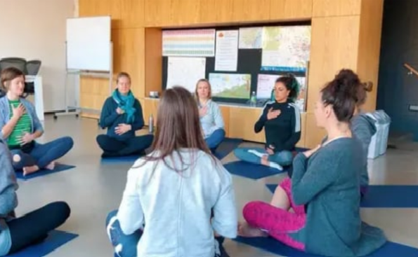
Staff Professional Development
Life Skills Group is offering expert professional development sessions for educators which are dedicated to providing practical and interactive training to improve your personal, staff and student wellbeing. These sessions will be delivered by our experienced team, who have lead educator and student wellbeing professional development in Australia and internationally for over a decade.
Programs include:
Building Emotional Literacy and self-regulation in our young people.
Wellbeing: It’s Not Just a Policy
Building Healthy Communities
Rebuilding and Refocusing
All programs count towards NESA elective hours.
Delivery can be flexible to suit your team, please contact us to discuss how we can best support you.
Learn more about our Professional Development sessions

Slide 21
Request your free 14 day trial of the GO Sentral integration
Click here to request access

Slide 22
Book a wellbeing consultation
Discuss your school’s wellbeing activity and how to wrap support around all of your programs.
Book Now

